Slide 1
KOKOnet PRODUCTS
KOKO Point app
Customer app
Customer Helpline
Customer interfaces
Agent web app
Agent
Tanker app
Driver app
Depot Web app
Wholesaler
Ops web app
Network Ops
Mobile interface
Web interface
Voice/SMS interface

Slide 2
Product Managers:
SmartCook Customer
Agent
Fuel Wholesaler
Advertising
Product research
Develop
and Test
Deploy
Maintenance and feedback
Design and prototype
Engineering Team:
4 x server side engineers
2 x android engineers
2 x electronics engineers
2 x test engineers
KOKO Product
Development Cycle

Slide 3
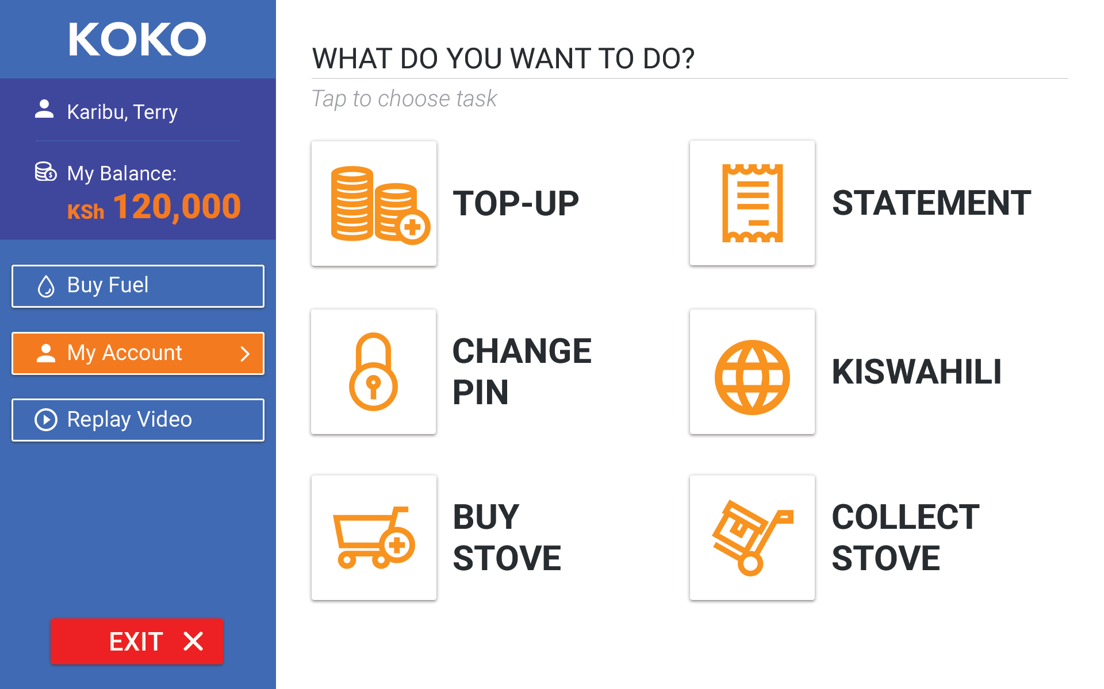
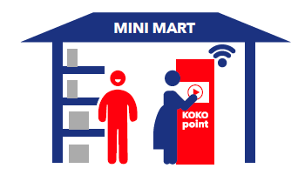
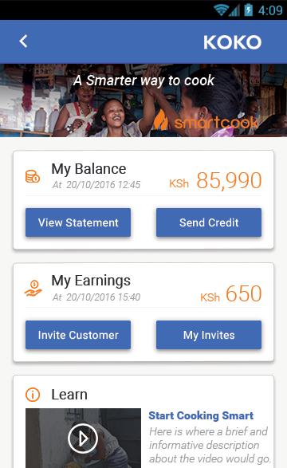
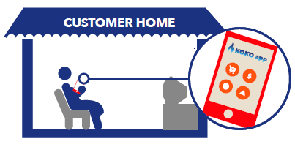
Customer interfaces
KOKO point
KOKO App
Allow customers to:
Market smartcook stove
Earn money through conversions
Send money to other KOKO customers
Learn cooking tips
Learn about other products
KOKO helpline

Slide 4

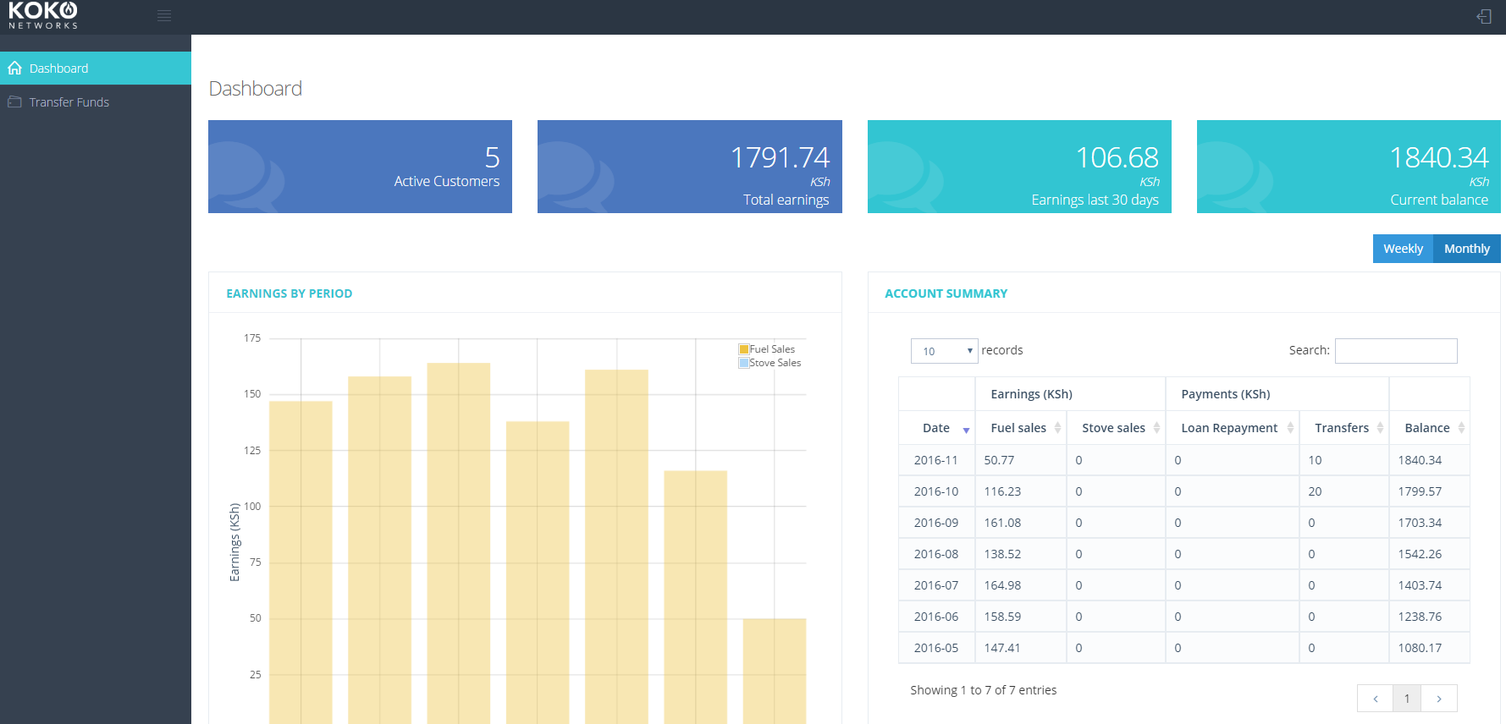
Agent interface
Agent Web App
Our KOKO Agents can:
Understand performance of their investment
Transfer their earnings to their bank account

Slide 5
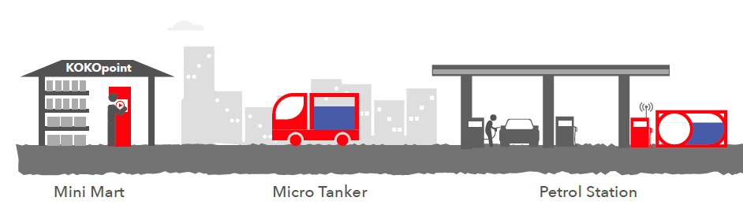

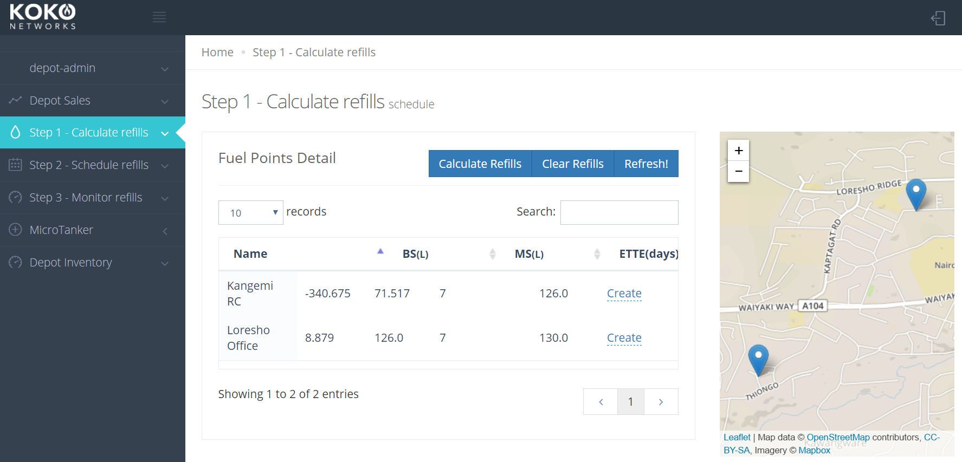
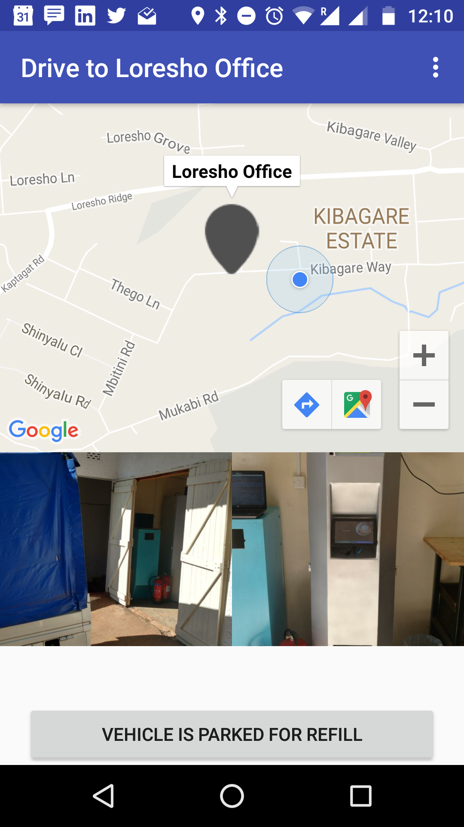
Wholesaler
Depot Web App
Driver App

Slide 6
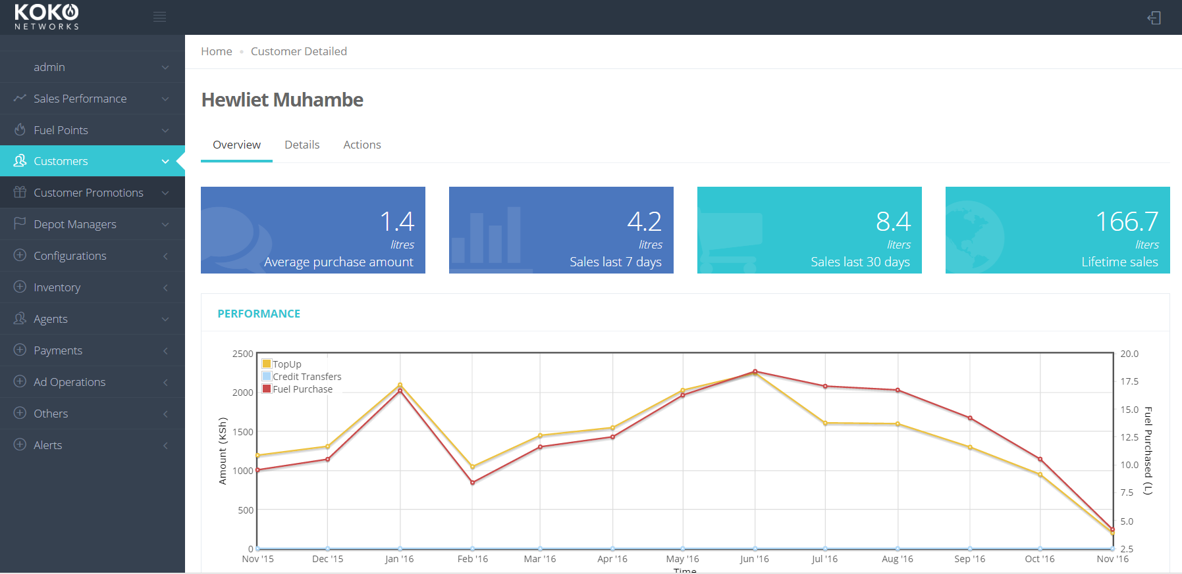
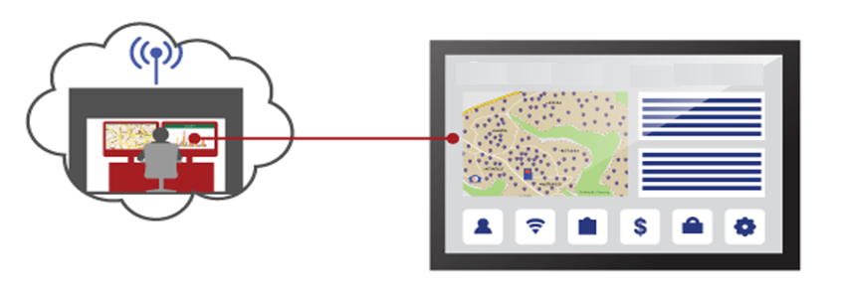
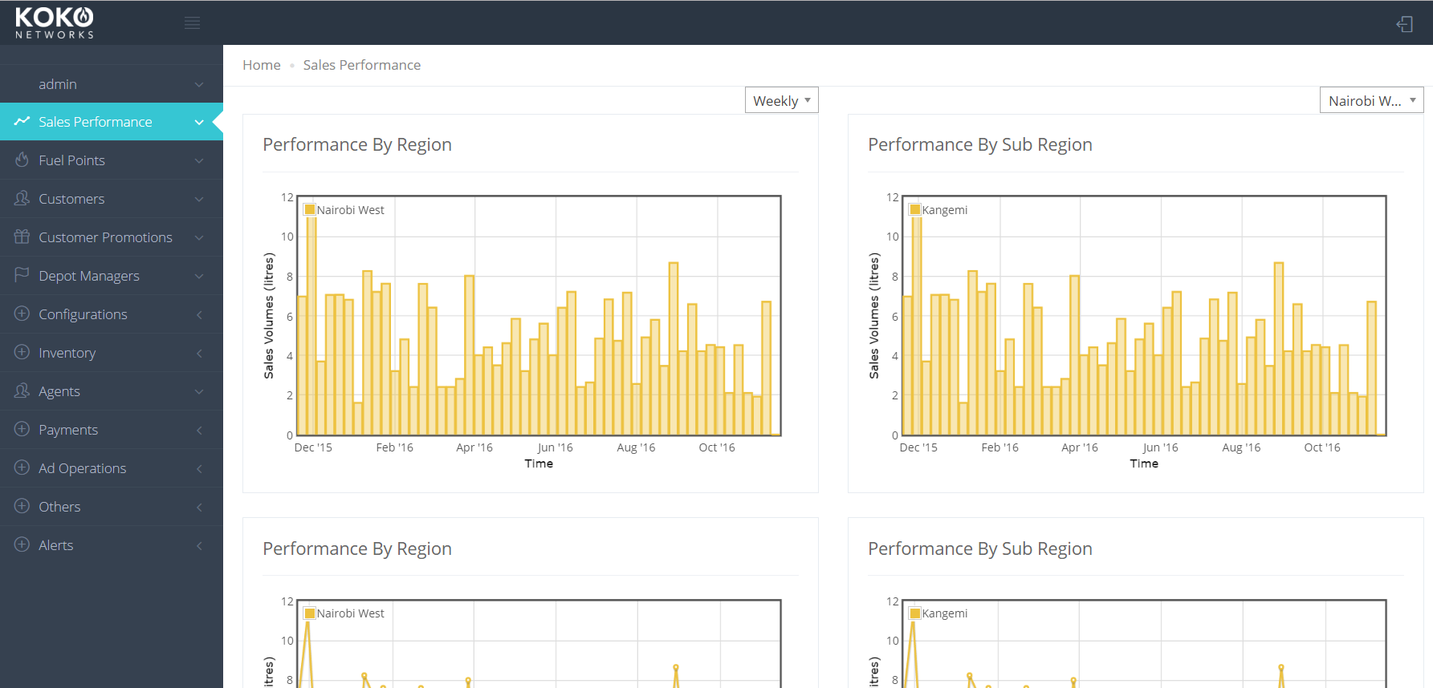
Network Operations & Management

Slide 7
Development Timeline
Technology Demo
Test Rollout
Commercial Soft Launch
40 Customers
1 KOKOpoint
1 MicroTanker
600 Customers
3 KOKOpoints
1 MicroTanker
20,000 Customers
100 KOKOpoints
2 MicroTankers
Objectives For Systems Development
Iterate on consumer products
Iterate on retailer & wholesaler products
Refine & adapt for commercial rollout
Team Growth
10 full time
engineers
12 full time engineers (addition of ops)
15 full time engineers
(more dev & ops)
Key Engineering Challenges
Meeting consumer needs in a robust & enjoyable way
Making operations smooth for our partners Operational support
Scaling services while maintaining excellent experience for customers & operating partners

